Slide 1


IBM Project Presentation on “Predictive Time Series Analysis Using LSTM and Flask”
By
Group ID: G23
NITYAM CHETAN BHOJANI (22162122002)
TRIVEDI CHIRAG RAJESHBHAI (22162172005)
PATEL SHIVAMKUMAR SUNILBHAI (21162101019)
Under the guidance of
Prof. Umang Thakkar
Institute of Computer Technology, Ganpat University
Date: 7-8th May 2025

Slide 2
Table of Contents
Project Overview & Team
Introduction
Deep Learning Model Used
Web Application Implementation
Challenges & Solutions
Glimpse of Our Application
Conclustion & Future Enhancements

Slide 3
Project Overview & Team
Overview
Team Tasks
Stock prediction system using deep learning.
Chirag: Vulnerability Report, CI/CD Pipeline
Flask for UI.
Shivam: Model development, UI.
Nityam: Model training, UI.

Slide 4

Introduction
1
Objective
2
Key Models
3
Tech Stack
Build stock market prediction model.
LSTM, GRU.
Python, Flask, Plotly, Alpha Vantage API, React and Redis.

Slide 5

Deep Learning Models Used
LSTM
Overcomes vanishing gradient problem.
GRU
Computationally efficient.

Slide 6
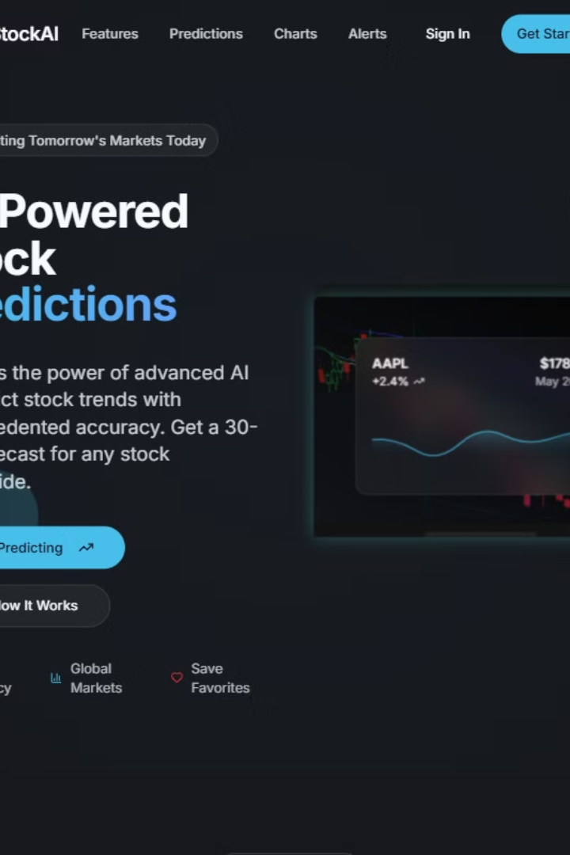



Web Application Implementation
Framework
UI Features
Security
Flask for backend API and data visualization.
User input, Graphs displaying predictions.
Checkmarx ZAP vulnerability scanning.

Slide 7

Challenges & Solutions
1
Challenges
Data inconsistencies, Overfitting, API rate limits.
2
Solutions
Data augmentation, Dropout layers, Efficient API handling.

Slide 8
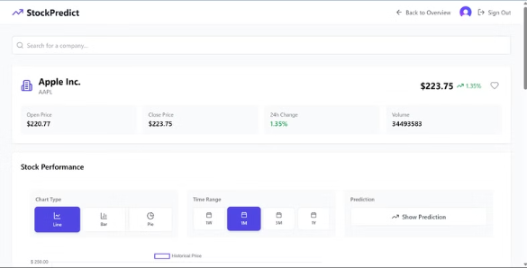
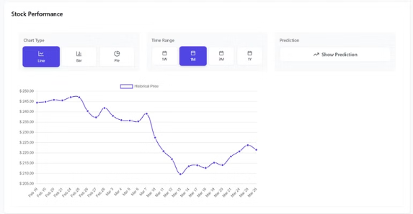
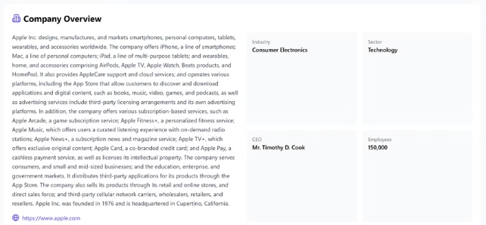
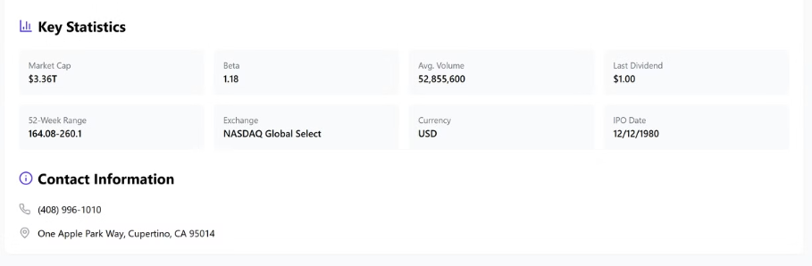
Glimpse of our application

Slide 9
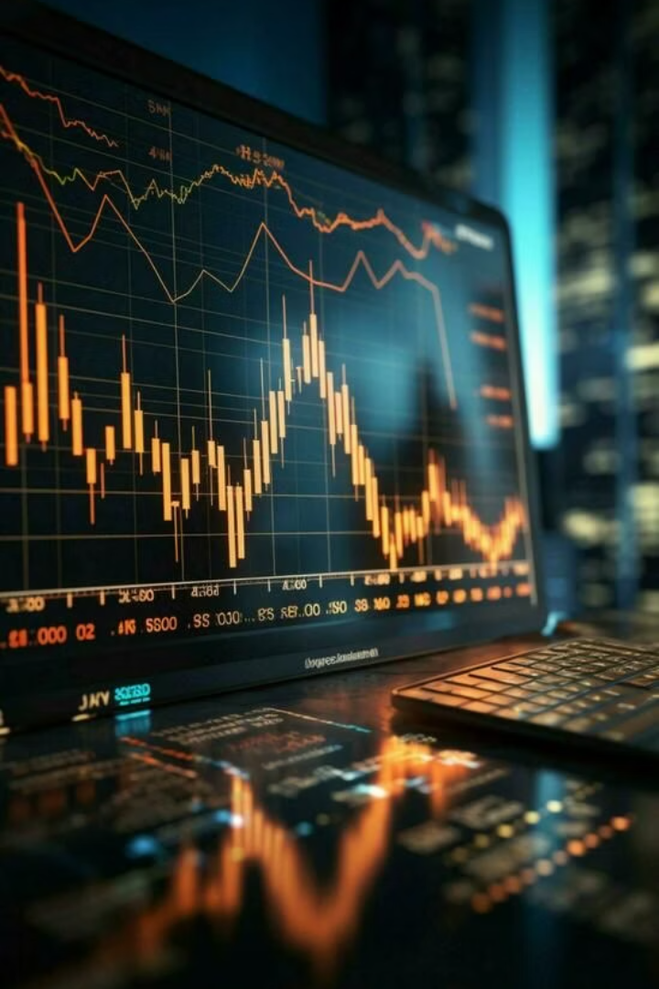
Conclusion & Future Enhancements
Summary
Successfully built a stock market prediction system.
Future Scope
Create Admin Dashboard

Slide 10
References
Alpha Vantage API Documentation - https://www.alphavantage.co/documentation/
TensorFlow & Keras Documentation - https://www.tensorflow.org/
Flask Documentation - https://flask.palletsprojects.com/
React.js Official Docs - https://react.dev/
Checkmarx ZAP Security Reports - https://www.zaproxy.org/
Redis Official Documentation - https://redis.io/
Stock Closing Price Prediction using Machine Learning Techniques: https://www.sciencedirect.com/science/article/pii/S1877050920307924
Machine Learning Stock Market Prediction Studies: Review and Research Directions: https://scholarworks.lib.csusb.edu/cgi/viewcontent.cgi?article=1435&context=jitim

Slide 11
Thank You!!

